Slide 1
More Personal Computing
Andy and Nikola

Slide 2
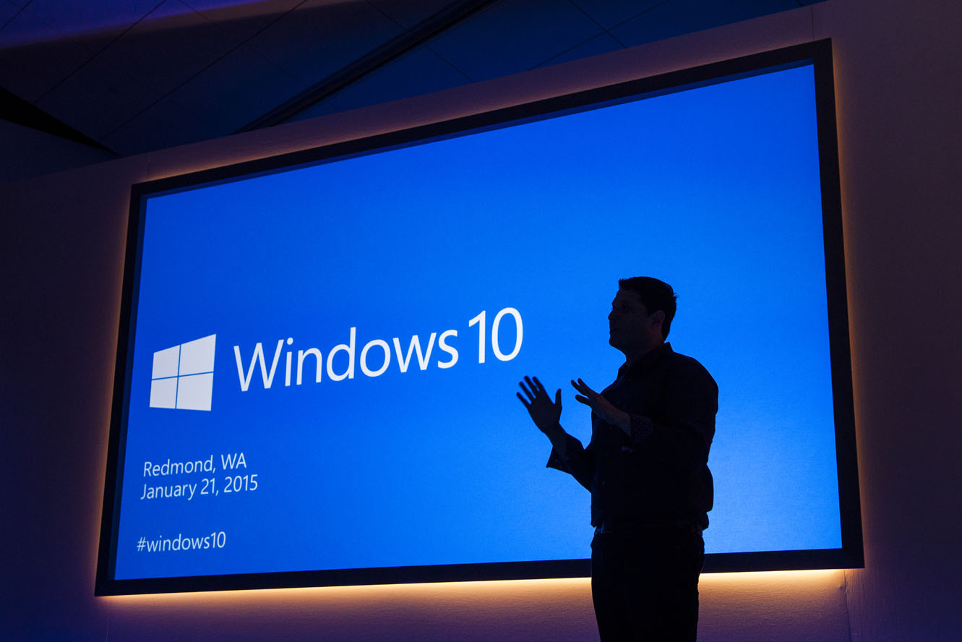
“Windows 10 is the first step to an era of more personal computing”
Terry Myerson
Notes:
Mobile first, cloud first helps us understand what happens when devices and the cloud are operating at scale together. More Personal Computing helps us think about how our interactions with our computers should evolve so that we can get more done, more quickly.
Kinect for Xbox One is a great example of a computer and an operating system that is natural and sensor aware. When you enter the room, the Kinect sees you, recognizes you, logs you in and asks you if you wish to engage. With your voice, or with gesture, or with a game controller, you can start a movie, play a game or even start up a Skype conversation. In Windows 7 and 8, Kinect for Windows brought a lot of this capability to the PC at an application level… with Windows 10, we are starting to enable this into the core operating system.
As we move into the future, our computers will do more. They will have sensors so they can start seeing the real world, they’ll use the cloud to help them understand what they’re observing, and we’re changing how we engage with them, and also how they interact with us.
We’re at start of something new and special..
While this is a different kind of computing, the reason we compute has never changed. We use computers to make the most of our precious time.
The idea behind more personal computing was whether we could add something new to how we work with our computers. What If we could engage them as naturally we can engage each other, maybe we could get stuff done faster, so we could spend more time doing whatever matters most to us.“

Slide 3

Gesture
Ink
Speech
Identity

Slide 4
Gesture

Slide 5
Ink

Slide 6
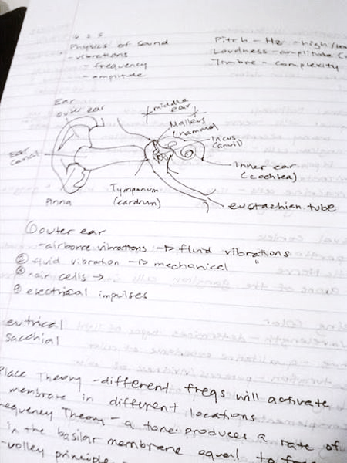
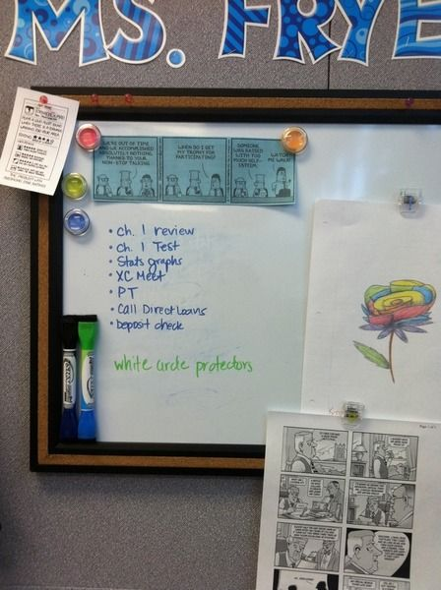
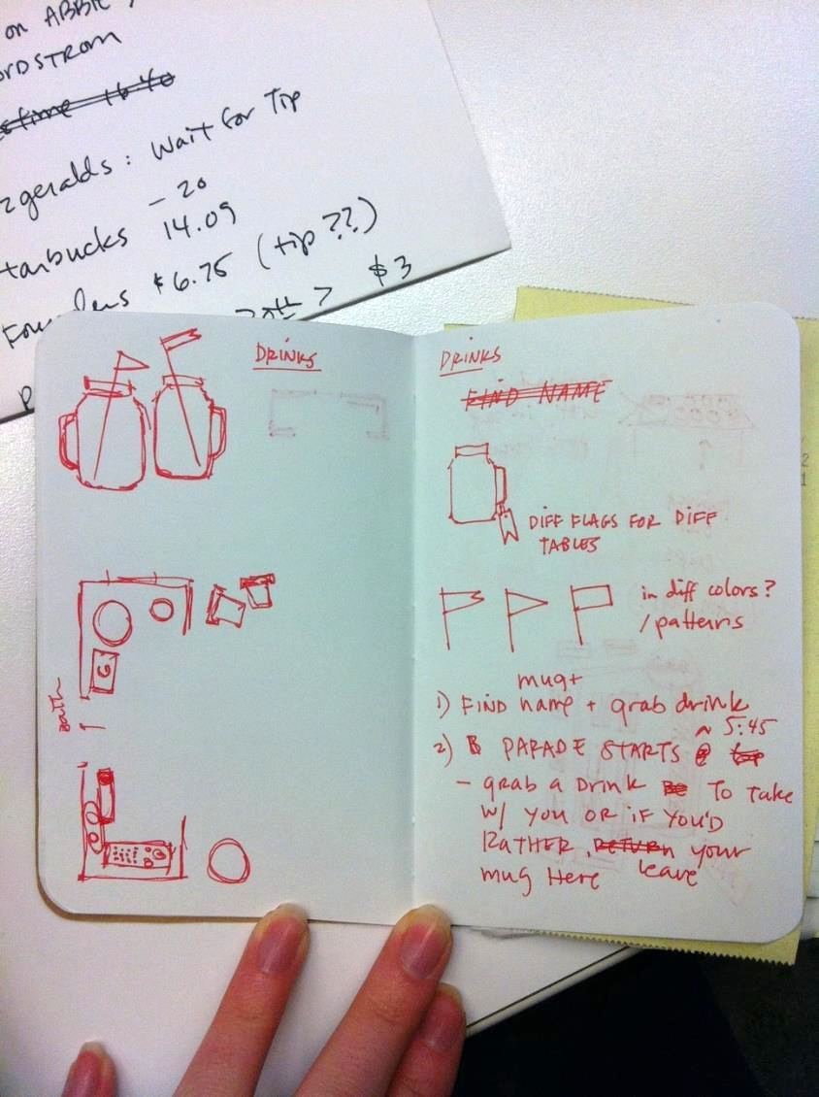
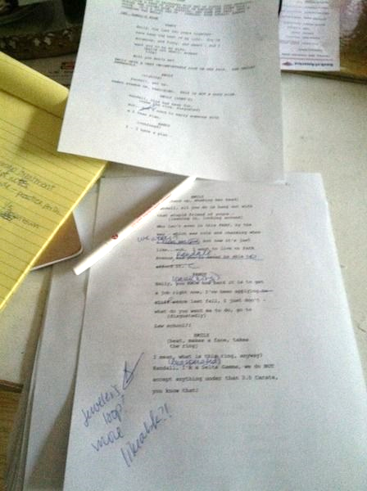
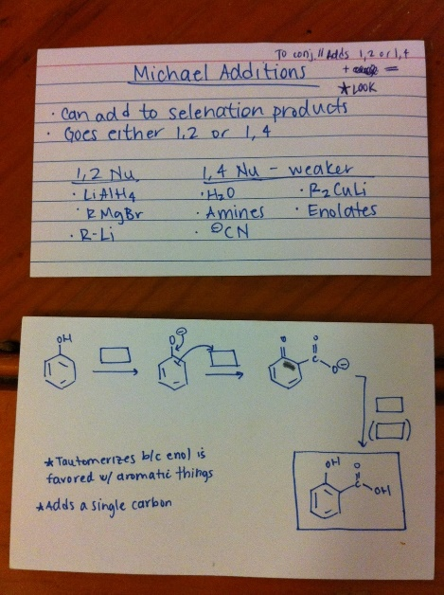
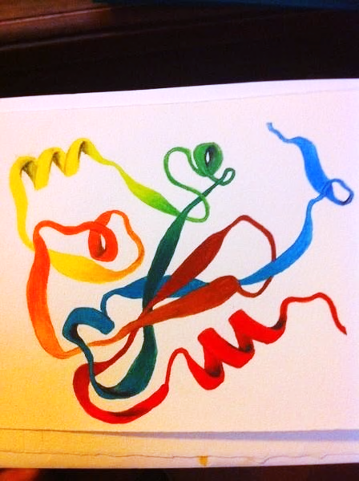
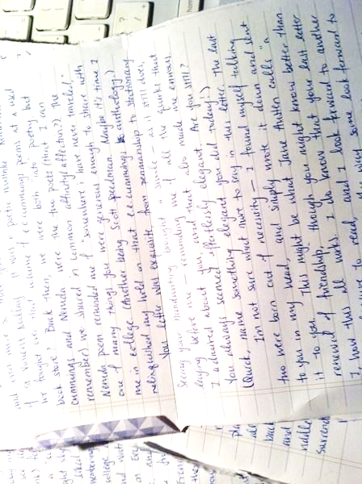
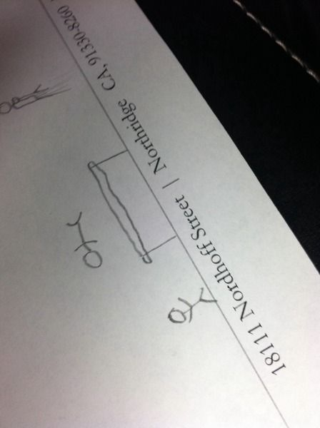
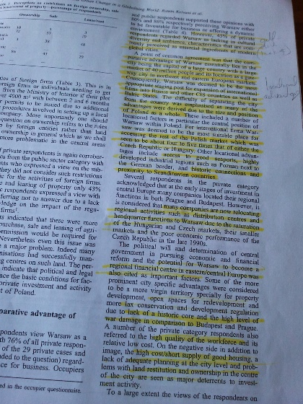
Writing is human.
Immediate
Expressive
Personal

Slide 7
Power of digital ink: Advancing human writing
As easy as pen & paper, and harnessing the power of the computer

Slide 8
DirectInk: New ink platform for Windows apps
Inking Support on PC, Tablet & Phone
Renders beautiful ink with low-latency
Improved Comfort and Confidence
Easy to use building blocks for apps

Slide 9
Getting Started with DirectInk
InkCanvas
InkPresenter
Advanced Input Processing

Slide 10
Do more with InkPresenter
Configure for different input types (Pen, Touch, Mouse, etc.)
Change Drawing Attributes
Manage Ink Stroke Data
Access more customization options
InkCanvas
InkPresenter
Advanced Input Processing

Slide 11
Speech

Slide 12
Identity

Slide 13

Introducing Windows Hello
Windows 10 supports three types of biometric:
Fingerprint
Face
Iris
All three are recommended gestures on devices with supporting hardware
Integrated with Windows Biometric Framework
Use Windows end to end experiences and scenarios
share the same design language for enrollment and usage

Slide 14
Demo: Unlocking Windows 10 using Windows Hello

Slide 15
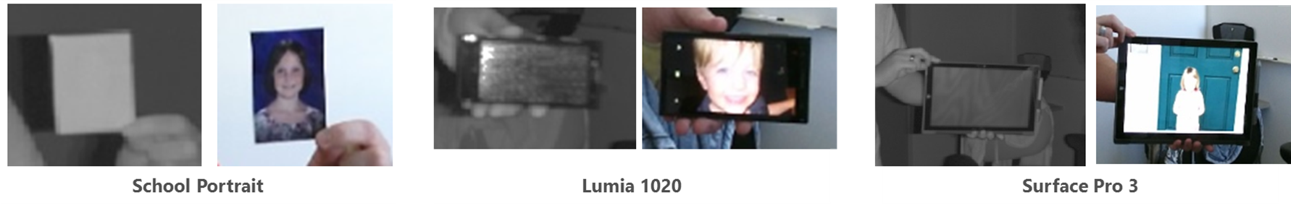
Windows Hello: Enterprise-grade Security
Meets enterprise-grade security:
Demonstrate False Acceptance Rate (FAR): 1/100,000
With False Rejection Rate: 2-4%,
Provide live-ness measures
Enable anti-spoofing detection

Slide 16
Windows Hello: Sensor Support
Fingerprint
All current fingerprint capable devices are supported
Face
All current (f200) and future Intel® RealSense™ are supported for Windows Hello face authentication
All devices that include an IR sensor that meets Microsoft sensor spec
Iris
A selection of devices will be arriving to market within the next 12 months
More details on sensor requirements and support coming soon

Slide 17
Agenda
Windows Hello
Microsoft Passport
Developer Experience

Slide 18
Going beyond passwords
Problems:
Passwords are hard to remember
Passwords are re-used -> server breach attacks
Microsoft passport solution:
User has to remember only one PIN or can use Windows Hello
No secret is stored on servers -> Two factor authentication with asymmetric keys

Slide 19
Strong user authentication – For everybody!
Azure AD, on prem AD, and Microsoft Account are already integrated with Microsoft passport
Developers have access to Microsoft Passport
Microsoft is in FIDO and our Microsoft Passport will be a reference implementation for FIDO 2.0

Slide 20
Windows 10 and Microsoft Passport Simple for Developer
Reduces the cost associated with password compromise and reset
Native API support for strong authentication via Universal Windows Platform
JavaScript API support for browsers coming later this year.

Slide 21
How could a 4-digit PIN be more secure?
Attacker needs to know both your PIN and have access to your device
TPM provides anti-hammering support to help thwart offline attacks
Hardware bound keys cannot be stolen or replayed
PIN is never stored in the device or sent to server

Slide 22
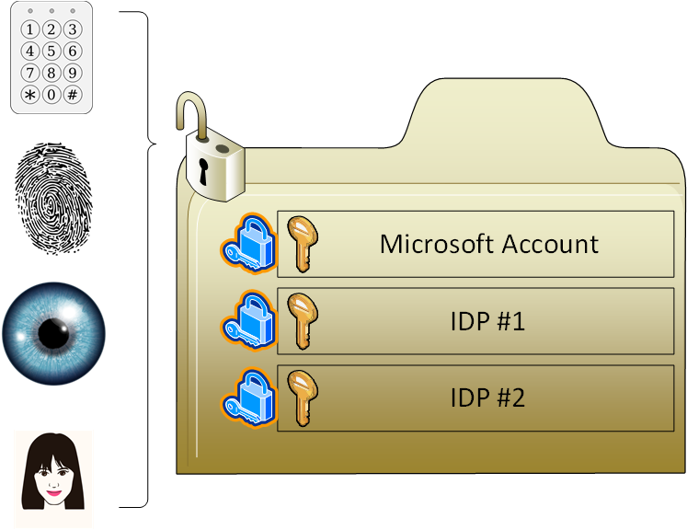
Preserving my privacy

Slide 23
Demo: Application using Microsoft Passport

Slide 24
Microsoft Passport: Provisioning
Two Step Verification
Create Microsoft Passport
Register Public key with Server
KeyCredentialRetrievalResult kcResult = await
KeyCredentialManager.RequestCreateAsync(accountID, KeyCredentialCreationOption.FailIfExists);
IBuffer userPublicKey = kcResult.Credential.RetrivePublicKey();

Slide 25
Microsoft Passport: Usage
Open Microsoft Passport
Sign challenge from Server with Microsoft Passport
Send digital signature to server
KeyCredentialRetrievalResult kcResult = await KeyCredentialManager.OpenAsync(accountID);
KeyCredentialOperationResult kcOpResult = await kcResult.Credential.RequestSignAsync(serverChallenge);

Slide 26
Microsoft Passport: Deletion
Open Microsoft Passport
Delete Passport
Delete Public Key on Server
KeyCredentialRetrievalResult kcResult = await KeyCredentialManager.OpenAsync(accountID);
KeyCredentialManager.DeleteAsync(accountID);

Slide 27
Summary
Microsoft Passport: non-phishable, theft-resistance, strong user authentication
Built-in support for Windows Hello without any application code changes
Simple APIs without any crypto or biometric knowledge
No changes to transport protocols and limited changes to servers

Slide 28
Agenda

Slide 29
Demo: Hello devices

Slide 31
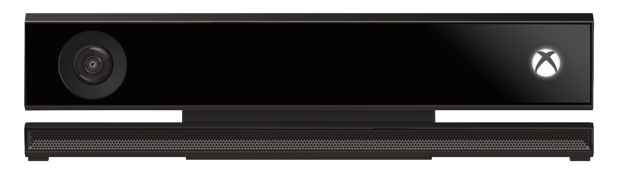
Kinect for Windows
Notes:
You can think of Kinect and Kinect for Windows as the source of inspiration for More Personal Computing in Windows 10.

Slide 32

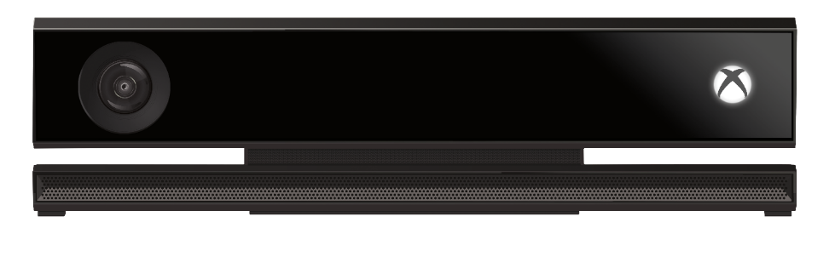
Kinect: Sensors and Software
A new kind of Camera, that can see in 3D
A traditional video camera
A 4-element microphone array
A powerful Software Development Kit which can:
Recognize that a person is in front of the sensor, and what position their body is in
A software controllable directional microphone, and speech recognition technology
And much more
Notes:
Kinect brought eyes and ears to the computer, with a 3D camera and video camera, very similar to the depth sensing used in the HoloLens, as well as a powerful 4-array microphone like what we now have in Surface Hub.
Additionally, Kinect brings with it many man years of Computer learning which has taught this sensor how to recognize a human, overlay skeletal and face information on that shape, and enable it to interact with your application. The depth sensor can see a room, and up to six people within that room, in true 3D.

Slide 33
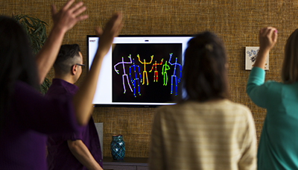
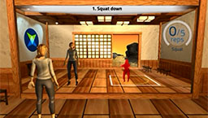
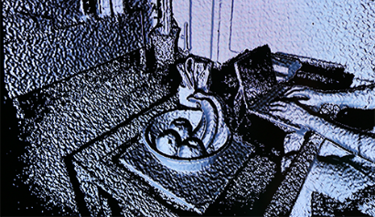
Capabilities
Build applications that understand people and the environment
Understands people, their posture, and movements
Measures & scans humans and the environment
Enable users to interact with machines in new ways
Gesture and voice-based interactions
Ambient measurement & analytics
Immersive experiences / augmented reality
Improved capabilities in V2
1080p video and 3x depth fidelity
Improved body tracking
Improved range & field of view
Publish Kinect-enabled applications to the Windows Store
Notes:
With Kinect for Windows developers can create applications that allow people to interact naturally with computers by simply gesturing and speaking. Kinect can identify when up to 6 people are in front of the sensor and can map 25 joints on to each of these skeletons. Kinect can also scan objects at very high accuracy for measurement and applications such as 3D printing.
These basic capabilities enable exciting human-computer interactions including the ability to control a computer through gesture. Beyond this, the possibilities get even more interesting, with the ability to measure, analyze and track many things about people, and immerse people into new environments and 3D games.
The Kinect for Windows v2 hardware, launched in the summer of 2014, gives developers more of what they’ve been asking for: more precision, responsiveness, and intuitive capabilities to take solutions to the next level, as well as the ability to use familiar development tools and publish their apps to the Windows Store.
Summary of the top V2 improvements:
- Improved depth and color - In V2 we’ve increased the depth fidelity by 3x and the color camera is running full 1080p HD video 1920x1080 running at 30 frames per second.
- Lighting independent IR – We changed the IR technology we use in the Kinect. In v1 we used structured light and in V2 we use time of flight. This results in a much cleaner depth image.
- Better body tracking - V1 has 20 skeleton joints for each skeleton and the sensor can track the skeletons of up to 2 people. In V2 we now have 25 joints per skeleton and can track up to 6 skeletons at once. We added two joints in each hand plus a collarbone joint. We’ve also improved the stability of each joint and made some improvements so joints are more anatomically correct. We track joint rotation as well as some different hand states. With the thumb and end of hand tracking we provide open and closed hand states.
- Improved range - V2 also has improved range, as close as 50 cm from the device and all the way out to 8 m.
- Wider field of view - We had a motor in the bottom of the sensor and we had an API that you could use to adjust the sensor up and down. In V2 we have a much wider field of view both vertically and horizontally. So there’s no longer a need for a motor in the base of the Kinect.

Slide 34
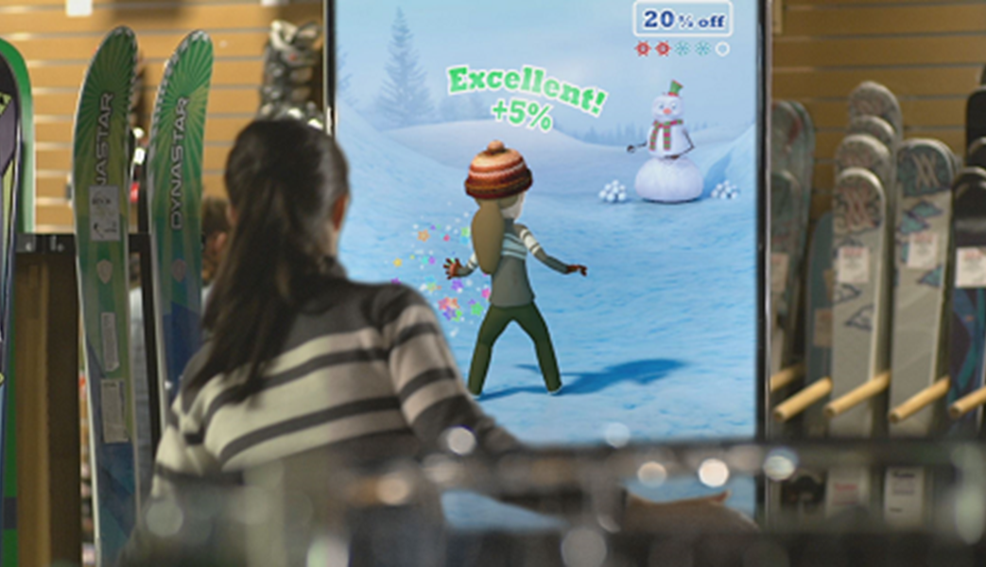
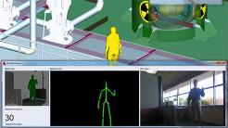
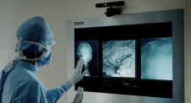
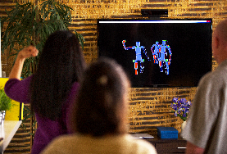

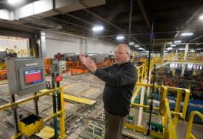
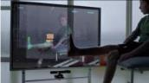

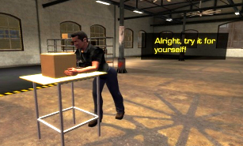
Commercial Applications & Markets
Retail
Manufacturing
Healthcare
Entertainment
Education & Training
Notes:
Since the launch of Kinect for Windows in 2012, and the upgrade to the v2 sensor last year, we have seen a wide variety of pilots and deployments across just about every industry.
In Retail we initially saw strong uptake in interactive digital signage and virtual dressing rooms. Lately we are seeing far more interest in getting anonymous shopper Analytics.
In manufacturing we are seeing Kinect used to better enable humans interacting in a space where robots are also present. Kinect can see the humans, and the robots will slow or stop for safety. Also using Kinect to access data through gestures for “dirty hands”
Which is quite similar to a key healthcare use case, where surgeons can access patient data from a distance without having to rescrub, saving time and saving lives. Also patient monitoring is a strong use case, where Kinect can monitor patients, as well as healthcare workers, to see if hands are washed before and after touching the patient.
We’ve seen numerous examples of Kinect for Windows for interactive movie premiers and other entertainment related engagements. As well as Education and training.
Any scenario where there is a desire to work with a large screen from a distance, or to measure and monitor humans, Kinect is turning out to be a cost effective solution.

Slide 35
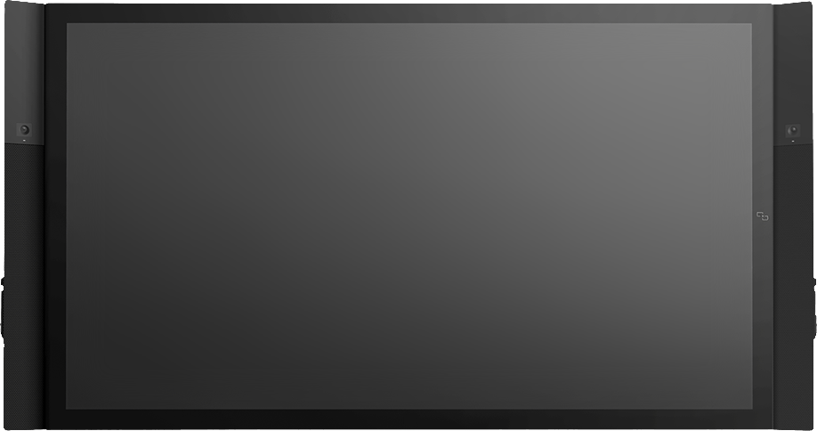
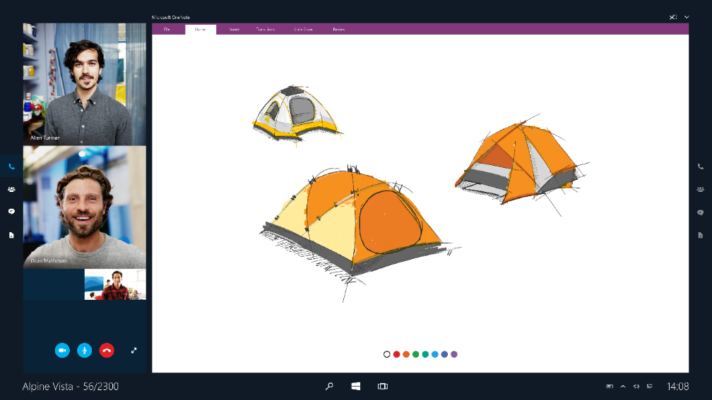
Microsoft Surface Hub
Notes:
An exciting new Windows 10 device coming soon from Microsoft is the Microsoft Surface Hub, designed to advance the way people naturally work together.

Slide 36
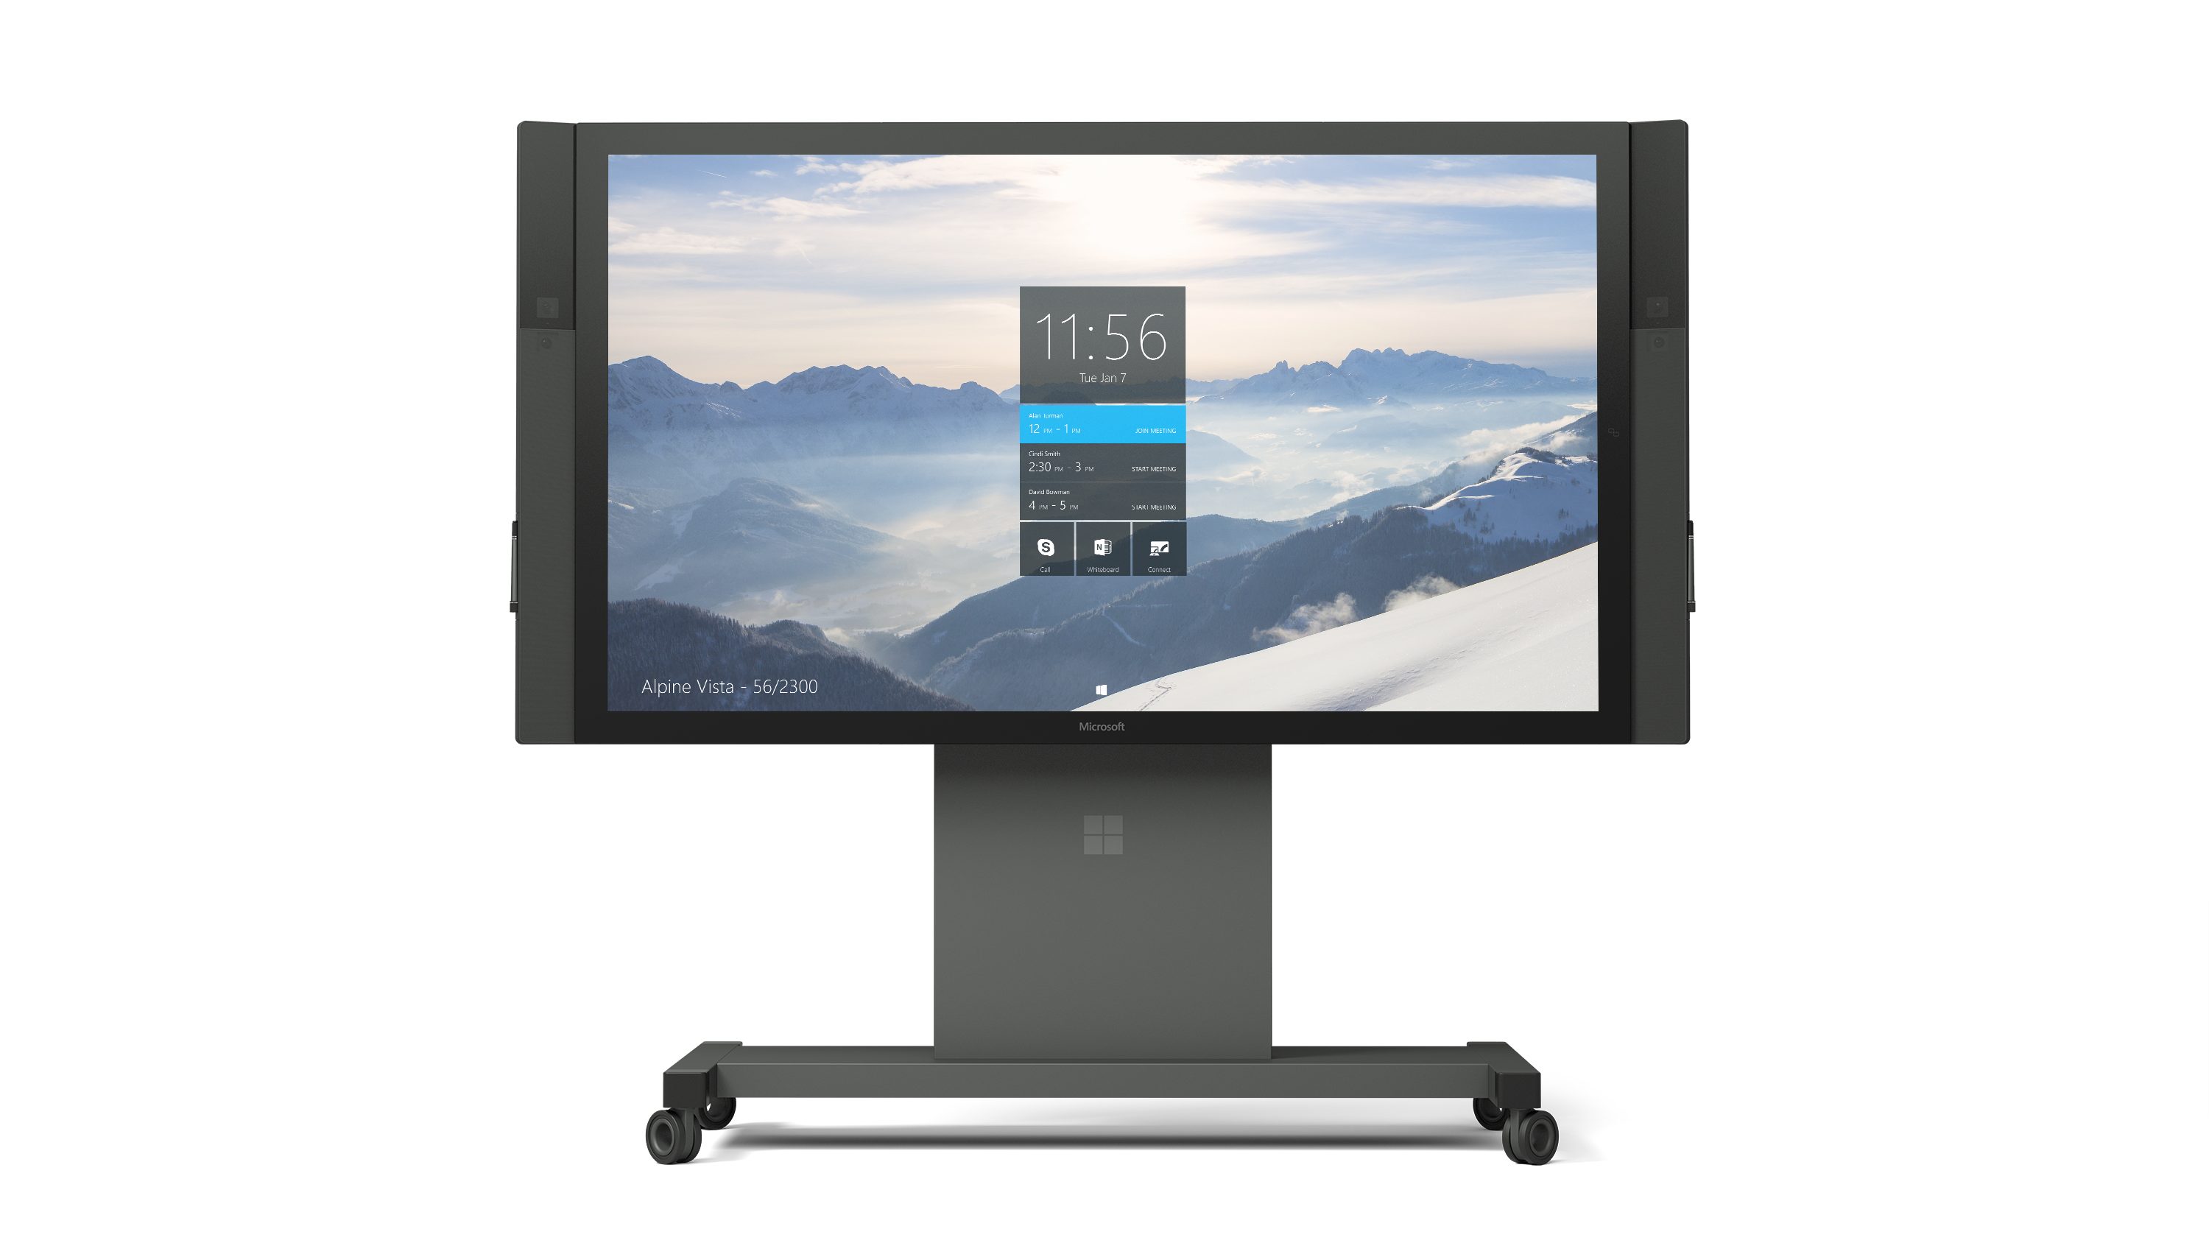
Microsoft Surface Hub – Unlock the Power of the Group
Best way to create and brainstorm with others
Engaging and productive meetings
Platform for amazing large screen apps
Advanced technology for the modern workplace
Notes:
The smart screen that enables you to accomplish more together. Our customer promise is to provide a tool that is:
Best creating and brainstorming: Whether in-person or remote, Surface Hub unites teams for working sessions, allowing groups to collaborate, white board, communicate, share, analyze and create as a group.
Engaging and productive meetings: Surface Hub reimagines the meeting experience, from instant start to pulling in meeting details and automatically syncing notes to help you eliminate to-dos that waste time and resources. Surface Hub also simplifies content sharing, allowing wireless projection from your laptop, tablet or phone with ink and touch back -- two people can even wirelessly project side-by-side, and even remote participants will automatically be able view all shared content.
Amazing Large Screen applications: Universal apps built for Windows 10 will shine on Surface Hub and scale for the large screen experience so that you can work in real-time and keep all participants engaged, co-create in the room or remotely and look and interact with data in new ways.
Advanced technology for the modern workplace: With an incredible display built for touch and inking and smart placement of cameras to engage remote participants naturally, Surface Hub is a powerful stage for sharing and interacting with content. Built as a complete device, Surface Hub is engineered for the modern workplace and can be deployed in rooms of all sizes. Whether you grab Surface Hub for a brainstorm in the office or video conference with your colleagues across the world, Surface Hub seamlessly integrates every detail in ways that are simple and intuitive for all users in the Enterprise.

Slide 37

Best pen and touch experience
Active pen
Very fast and accurate
Fully distinguishable from touch
Super fast multitouch on a large screen
Built from the ground up
120 Hz touch combined with 120 Hz display refresh
Up to 100 simultaneous touches plus 3 pens
Optically bonded sensor
Minimal parallax, stiff under touch and very robust
Engineered surface
Thermal control
Anti glare coating
Low, consistent friction surface
Notes:
The touch is built from the ground up for uncompromised performance. It has:
An expansive glass surface that has careful thermal control, allowing you to stand in the device all day without becoming over heated
There is an anti glare coating, which educes annoying specular reflection and resists fingerprints
The surface has low and consistent friction that feels great under fingers and writing with pen feels natural
The glass is an engineered surface that is strong, scratch resistant, and easy to clean.

Slide 38
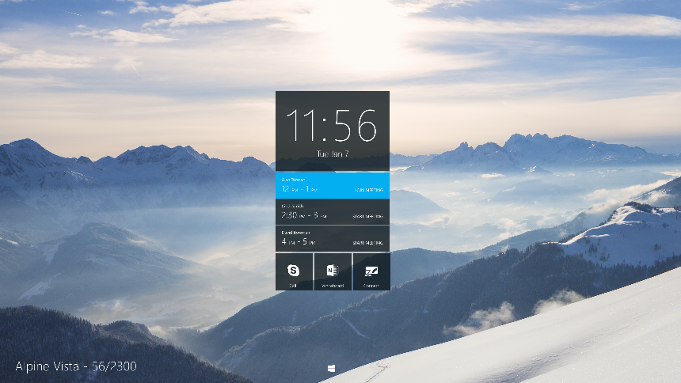
Designed for a collaborative experience
Microphone Array
Wide Angle Camera 1080p
Wide Angle Camera 1080p
High resolution cameras
1080P resolution
1/3.2” sensor
Hyperfocal
Side mounted
More natural viewpoint for remote participants
Dock gallery along side gutter, head gaze naturally indicates attention
Wide angle
View of the full room
View of a user interacting with the screen
Speakers
Speakers
Microphone array
Front facing, stereo speakers
High performance, 4 element array
Skype certified for great sensitivity, response, echo cancellation, and distortion
Optimized for voice
Full range, 160 Hz to 20 KHz
Notes:
The technology is designed to create a collaborative AV experience. The Microphone array is a high performance four element array and is Skype certified for great sensitivity, response, echo cancellation and distortion.
The two front facing stereo speaker are optimized for voice and provide a full range of 160Hz to 20 KHz
The two high resolution cameras are 1080p, contain a 1/3.2” sensor, and are hyperfocal. The cameras are side mounted to create a more natural viewpoint for remote participants. The cameras were also chosen to be wide angle in order to get a full view of room and a view of user interacting with the screen

Slide 39

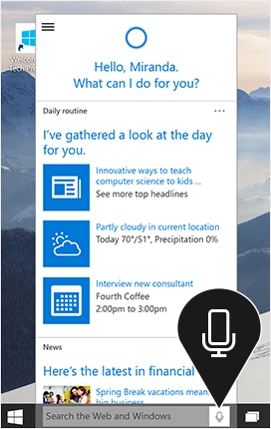
More Personal Computing | Cortana
Speech and
Audio
Features
Reminders, based on your calendar, your location, and variables like traffic and flight delays
Finding stuff - Search
Managing tasks
Support for text and speech input
Application integration
Notes:
What the audience should learn from this slide:
Speech/Cortana is really about getting things done in a natural way, across a wide variety of devices, all enabled by the Unified Windows Platform
Suggested amount of time to present this slide:
<1 minute
Example script:
“Windows 10 brings the technologies in more personal computing to the full breadth of Windows 10 devices.
As just one example, Cortana’s voice recognition and natural language interaction is found in devices as varied as Windows Phone, Xbox One, Surface, laptops and convertibles from our OEM partners, our giant PPI screens, the Microsoft Band, and HoloLens. And regardless of which device you’re using, Cortana knows to pick up your conversation just where you left off when you were last talking.
All Windows 10 devices share the Windows Core, and they all run Windows 10 UWP apps. For developers, there’s a single Windows store, so their app experiences can be fully mobile across all the devices users have, powered by the more personal computing found in Windows 10.”

Slide 40
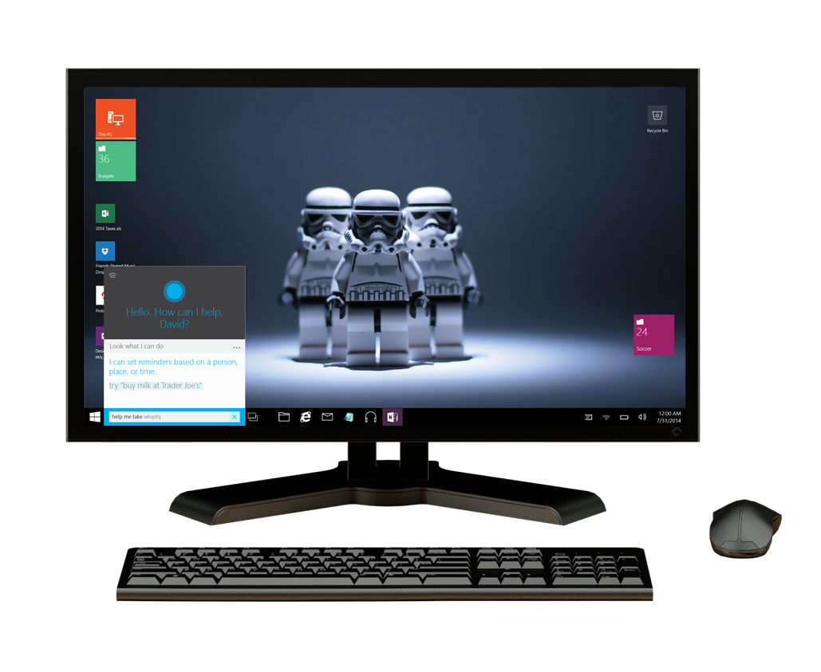
Cortana Promise
Speech and
Audio
A personal assistant not for all of us, but for each of us
Learns
likes, dislikes, routines
friends, family, clients
route, traffic, calendar
Transforms
your behaviors and patterns into
recommendations.
Natural voice and interactions
Notes:
As just one example, Cortana’s voice recognition and natural language interaction is found in devices as varied as Windows Phone, Xbox One, Surface, laptops and convertibles from our OEM partners, our giant PPI screens, the Microsoft Band, and HoloLens. And regardless of which device you’re using, Cortana knows to pick up your conversation just where you left off when you were last talking.
All Windows 10 devices share the Windows Core, and they all run Windows 10 UWP apps. For developers, there’s a single Windows store, so their app experiences can be fully mobile across all the devices users have, powered by the more personal computing found in Windows 10.”
A personal assistant not for all of us, but for each of us
The best personal assistants get to know the people they serve. They learn the likes, dislikes and routines, as well as friends and family, of their clients so they can better help and give relevant advice. The same is true of Cortana—the first truly personal digital assistant. She calls on your behaviors and patterns and transforms these into proactive, personal recommendations. She is discrete, keeping your personal information private, and can stop paying attention if you ask her to. Her natural voice and interactions make it easy to take action and find information quickly. And of course, she’s with you wherever you go – on your PC, tablet, or phone. Cortana’s the personal digital assistant tailored uniquely to you, helping you get things done throughout the day.

Slide 41
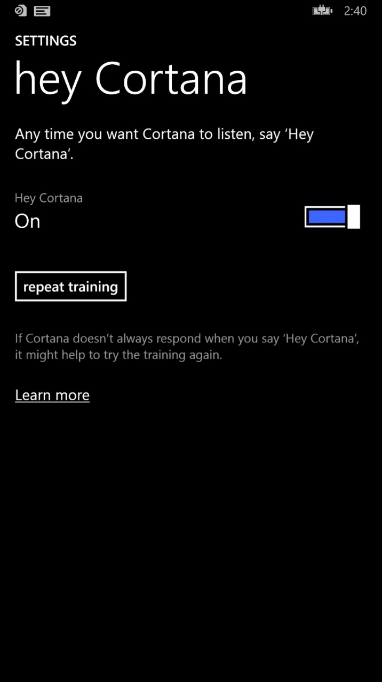
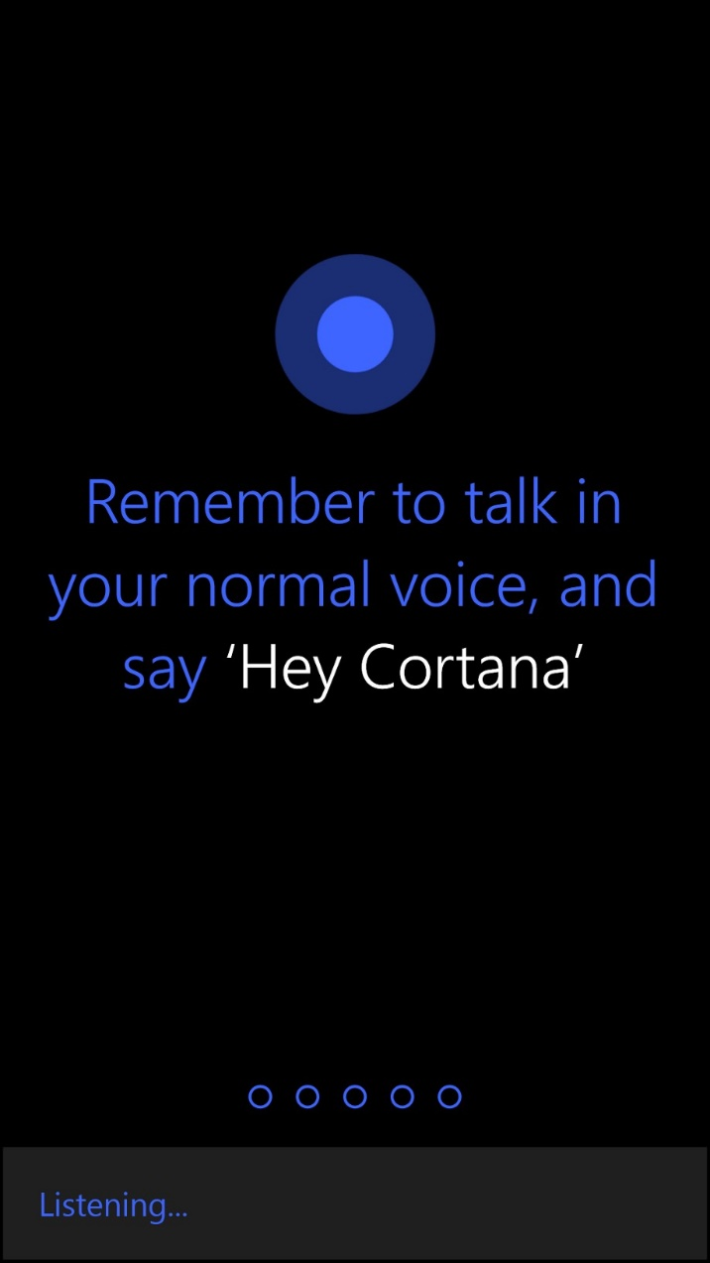
Hey Cortana
Active, authenticated device
Power efficient ambient listening
Personalized training to your voice
A natural speech experience
Notes:
Active, authenticated device
Power efficient ambient listening
Personalized training to your voice
Natural speech experience

Slide 42

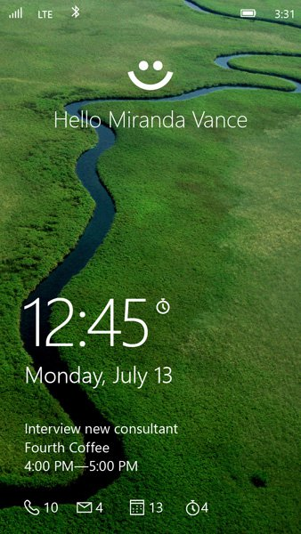
More Personal Computing | Identity
Identity and Biometrics
More secure, password-free experience, powered by Windows Hello and Passport
Windows Hello
Biometric authentication (face, iris, fingerprint)
Convenient, Consistent
Enterprise level security
Passport
More secure
Simplifies authentication through single “unlock gesture”
Just works Azure Active Directory services
Access to major SaaS services
Office 365 Exchange Online, Salesforce, Citrix, Box, Concur,
Notes:
What the audience should learn from this slide:
The human technologies that make more personal computing a reality are in the Windows Core and available to developers and device manufactures in Windows 10
We expect to see more personal computing in devices in all shapes and sizes with Windows 10
Suggested amount of time to present this slide:
And now we’ll run a short video on Windows Hello and Passport….

Slide 43

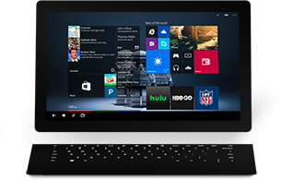
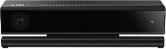
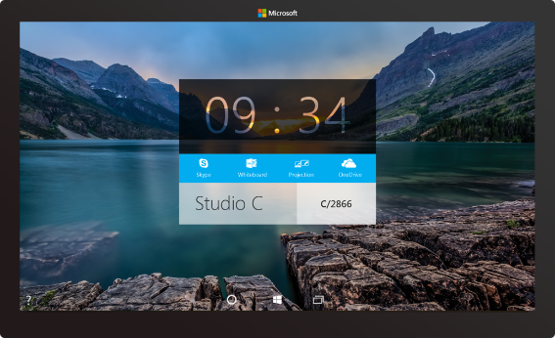
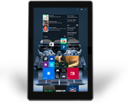

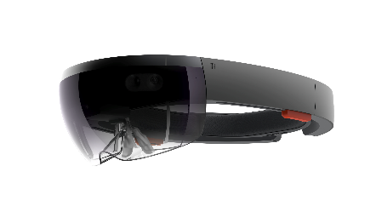



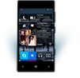
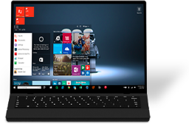
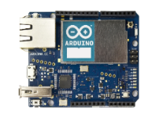

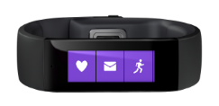
The Windows 10 family of devices
Microsoft Kinect for Windows
Microsoft Surface Hub
Microsoft HoloLens
Notes:
What the audience should learn from this slide:
The human technologies that make more personal computing a reality are in the Windows Core and available to developers and device manufactures in Windows 10
We expect to see more personal computing in devices in all shapes and sizes with Windows 10
Suggested amount of time to present this slide:
<1 minute
Example script:
“Windows 10 brings the technologies in more personal computing to the full breadth of Windows 10 devices.
As just one example, Cortana’s voice recognition and natural language interaction is found in devices as varied as Windows Phone, Xbox One, Surface, laptops and convertibles from our OEM partners, our giant Surface Hub screens, the Microsoft Band, and HoloLens. And regardless of which device you’re using, Cortana knows to pick up your conversation just where you left off when you were last talking.
All Windows 10 devices share the Windows Core, and they all run Windows 10 UWP apps. For developers, there’s a single Windows store, so their app experiences can be fully mobile across all the devices users have, powered by the more personal computing found in Windows 10.
We’ll share a bit more detail on the Micosoft Surface Hub, Kinect for Windows, and HoloLens.
”

